Slide 1
Lecture 13 Superposition Theorem

Slide 2
Superposition Theorem (Definition)
It states that the voltage across (or current through) an element in a linear circuit is the algebraic sum of the voltage across (or currents through) that element due to EACH independent source acting alone.
The principle of superposition helps us to analyze a linear circuit with more than one independent source by calculating the contribution of each independent source separately.

Slide 3
Steps to Solve Circuits using Superposition Theorem
To find the current/ voltage in any branch, take one source at a time and replace rest of the sources by their internal resistances (if given).
Calculate the current/voltage by any method(mesh/nodal/KVL/KCL).
Now calculate the current/ voltage in the same branch by taking the other source in the circuit and replacing rest of the sources by their internal resistances.
Repeat steps 1,2 till all the sources have been considered.
Total current/voltage in the given branch= algebraic sum of all the currents/voltages in the branch due to all the current sources.

Slide 4
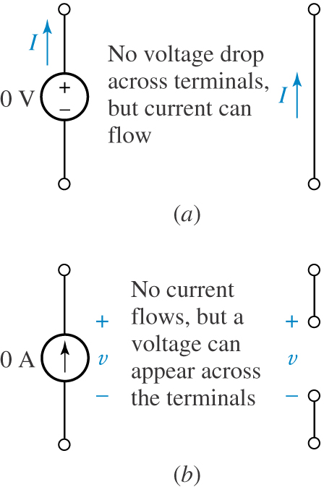
Implementation: Replacing the V or I sources when internal R not given
Replace V sources by Short Circuit if their internal R is not given
Replace I sources by Open Circuit if their internal R is not given

Slide 5
Example: Calculate the current through 1Ω resistor
(a)
(b)
(c)
Step 1:Only 1V source present
Replace 2v source by short circuit (SC)
I1 = 1A
Step 2: Only 2V source present (Replace 1V source by SC)
I2 = 2A
Step 3:
I total = 1+2 = 3A

Slide 6
Example: Calculate the current through 1Ω resistor
(a)
(b)
Step 1: 1A source acting alone (replace 2V source by SC)
I1 = 1A
Step 2: 2V source acting alone (replace 1A source by OC)
I2 = 0A
Adding the two currents considering their signs
I total = I1+I2=1+0 = 1A
(c)

Slide 7
Example 2: Find voltage Vx using superposition theorem

Slide 8
I1

Slide 9
I2

Slide 11
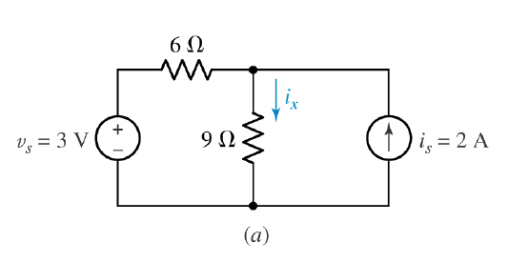
Example 3: Use superposition to find i_{x}

Slide 12
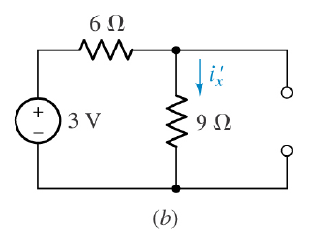
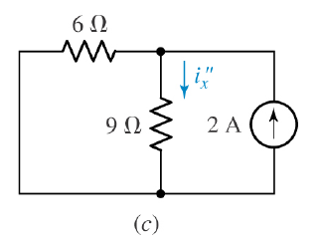
Step2:
Only 2A source connected(3V source is SC)
Step 1:
Only 3V source connected(2A source is OC)
= 2x6/(6+9)=0.8 A
=3/15=0.2 A
Step 3:Totalcurrent=0.2+0.8=1A
= 1.0 A

Slide 14
Step 1:
Only 10ma source connected in circuit(3mA source OC)
I=10mA
Step2: Only 3mA source connected(10mA source OC)
I’=3mA
Total Current:10mA-3mA=7mA

Slide 15
Thank you

